Slide 1
Discrete decision making
Lecture 1. Discrete Choice Models

Slide 2
Course objectives (Bounded rationality)
The leading paradigm in economic theory assumes that economic agents (households, firms) are perfectly rational in making their decisions. Experimental evidence and common sense indicate that this assumption is often too demanding. This course focuses on the analysis of bounded rationality models, where agents violate full rationality.

Slide 3
Discrete choice
Discrete choice models, or qualitative choice models, describe, explain, and predict choices between two or more discrete alternatives.
In the continuous case, calculus methods (e.g. first-order conditions) can be used to determine the optimum amount chosen, and demand can be modeled empirically using regression analysis. Discrete choice analysis examines situations in which the potential outcomes are discrete, such that the optimum is not characterized by standard first-order conditions

Slide 4
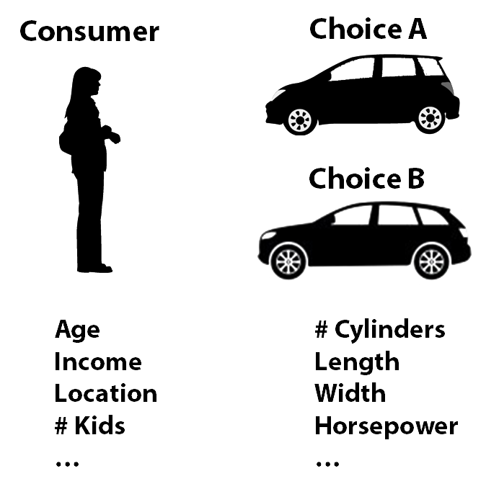
Example: Car choice

Slide 5
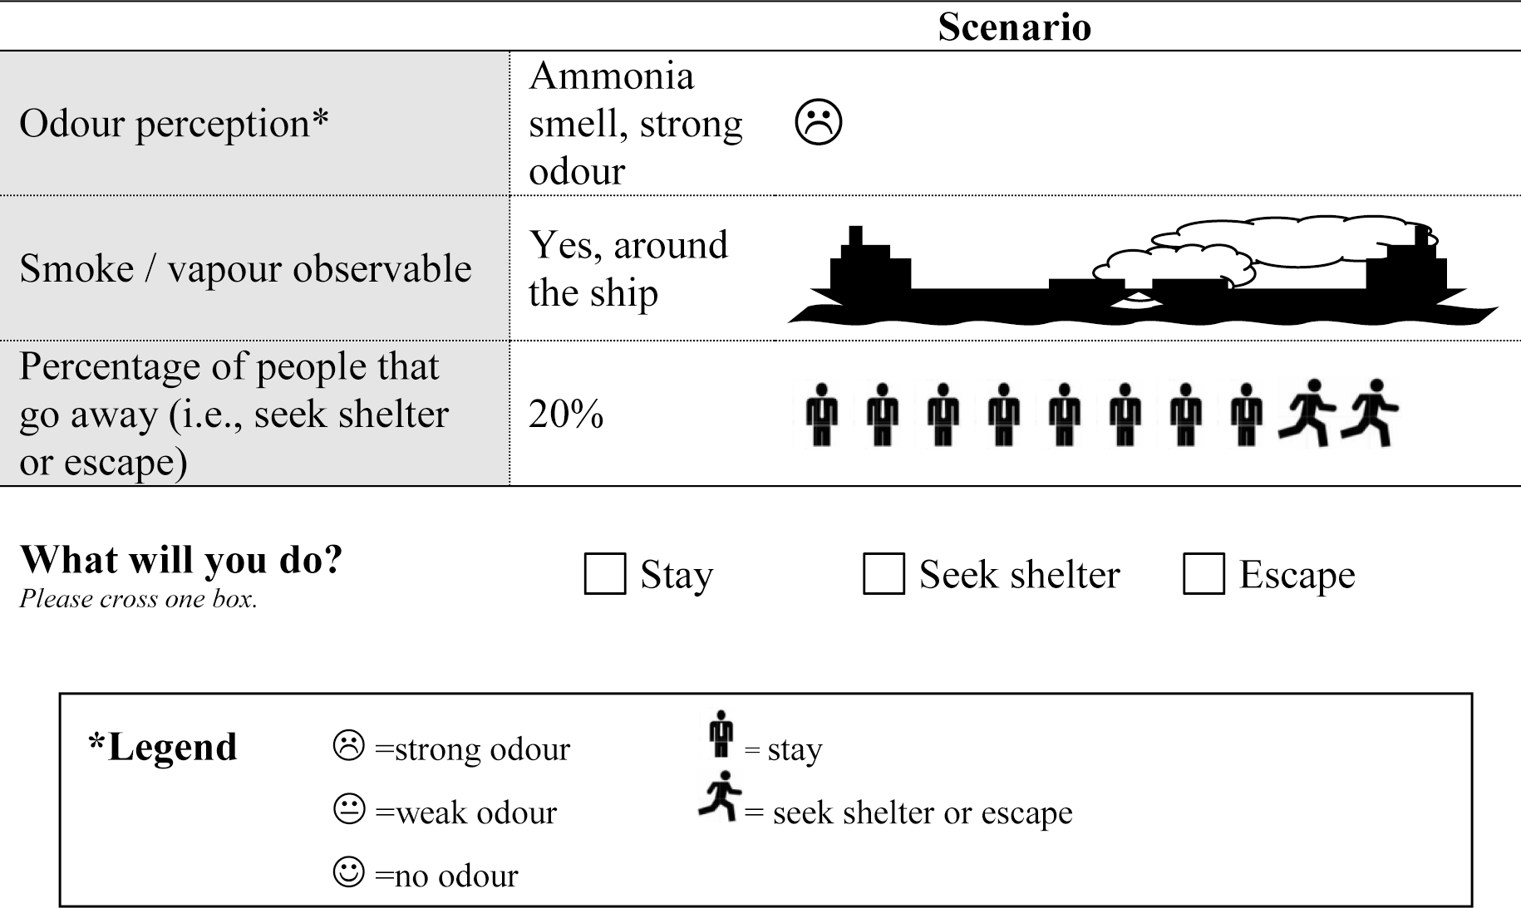
Protective behaviour of citizens to transport accidents
de Bekker-Grob E. W. et al. Protective behaviour of citizens to transport accidents involving hazardous materials: a discrete choice experiment applied to populated areas nearby waterways //PLoS one. – 2015. – Т. 10. – №. 11. – С. e0142507.

Slide 6
Applications of Discrete choice analysis
Marketing researchers use discrete choice models to study consumer demand
Transportation planners use discrete choice models to predict demand for planned transportation systems
Energy forecasters and policymakers use discrete choice models for households’ and firms’ choice of heating system
Labor economists use discrete choice models to examine participation in the work force
Evacuation modelling utilizes these models in order to simulate human behaviour during emergency situations

Slide 7
Choice set
The choice set is the set of alternatives that are available to the person. For a discrete choice model, the choice set must meet three requirements:
The set of alternatives must be collectively exhaustive, meaning that the set includes all possible alternatives. This requirement implies that the person necessarily does choose an alternative from the set.
The alternatives must be mutually exclusive, meaning that choosing one alternative means not choosing any other alternatives. This requirement implies that the person chooses only one alternative from the set.
The set must contain a finite number of alternatives. This third requirement distinguishes discrete choice analysis from forms of regression analysis in which the dependent variable can (theoretically) take an infinite number of values.

Slide 8
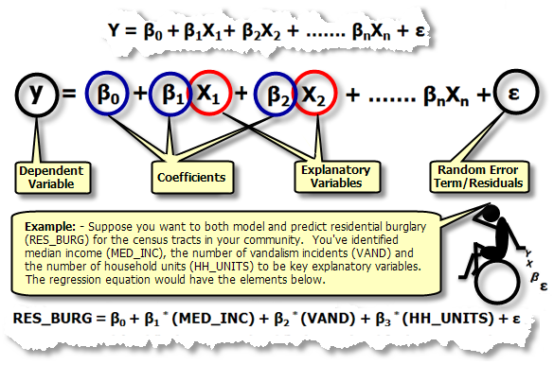
Regression analysis
Regression analysis is a statistical process for estimating the relationships among variables.

Slide 9
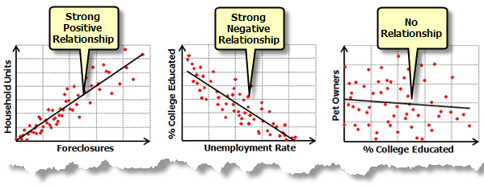
Types of dependence

Slide 10
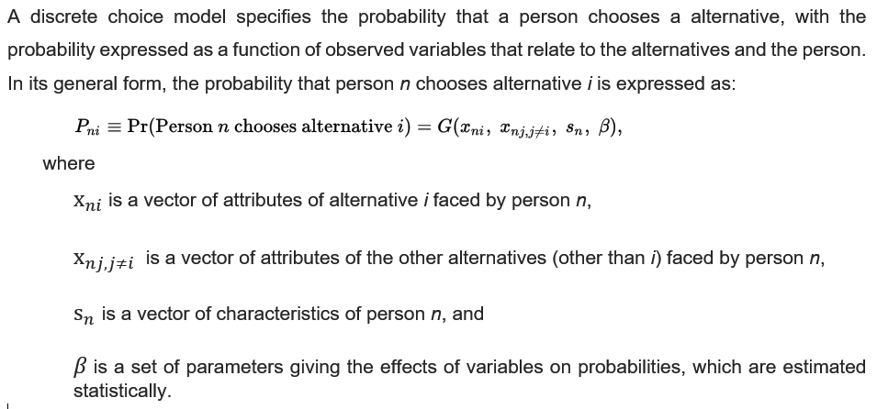
Choice probabilities

Slide 11
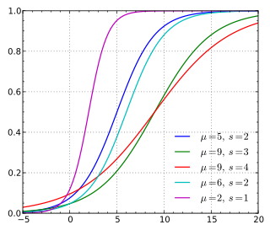
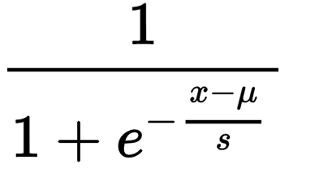
Logistic regression
Logistic regression, or logit regression, or logit model is a regression model where the dependent variable is categorical. It can take only two values, "0" and "1", which represent outcomes such as pass/fail, win/lose, alive/dead or healthy/sick.
The binary logistic model is used to estimate the probability of a binary response based on one or more predictor (or independent) variables (features). It allows one to say that the presence of a risk factor increases the probability of a given outcome by a specific percentage.
CDF is

Slide 12
Why Python?
Python is #1 language in scientific world
It has lots of useful libraries (solvers, optimization, geometry etc.)
It has well developed visualization tools (matplotlib)
It’s free!

Slide 13
Tools: statsmodels
statsmodels is a Python module that provides classes and functions for the estimation of many different statistical models, as well as for conducting statistical tests, and statistical data exploration. An extensive list of result statistics are available for each estimator. The results are tested against existing statistical packages to ensure that they are correct. The package is released under the open source Modified BSD (3-clause) license. The online documentation is hosted at statsmodels.org.

Slide 14
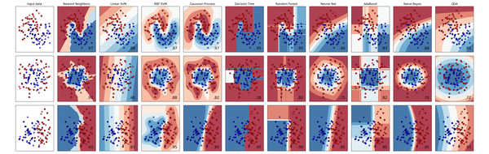
Tools: scikit-learn
Simple and efficient tools for data mining and data analysis
Accessible to everybody, and reusable in various contexts
Built on NumPy, SciPy, and matplotlib
Open source, commercially usable - BSD license

Slide 15
Artificial (dummy) data
Test data is data which has been specifically identified for use in tests, typically of a computer program.
wikipedia.org
Dummy data is benign information that does not contain any useful data, but serves to reserve space where real data is nominally present. Dummy data can be used as a placeholder for both testing and operational purposes.
wikipedia.org

Slide 16


Example: voting
vs

Slide 17
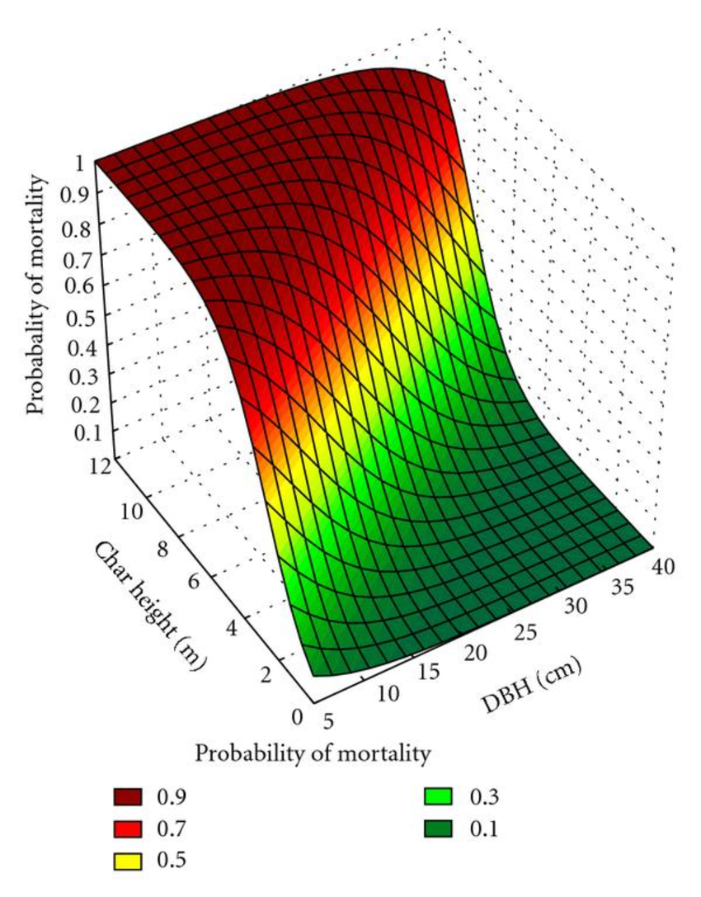
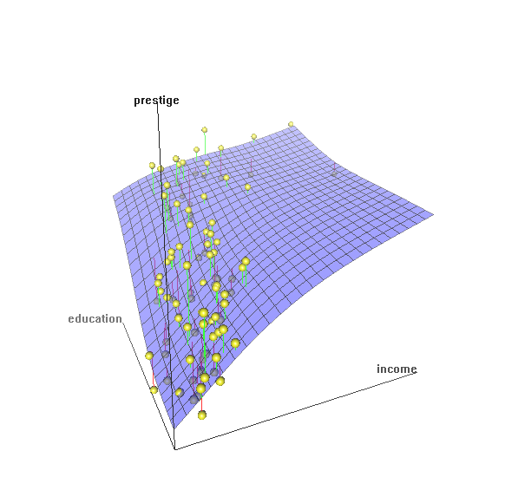
Two variables output

